Slide 1

MADAN BHANDARI COLLEGE OF ENGINEERING Urlabari-03, Morang
Title Defense of Final Year Project on:
“AI-Powered Research Paper Recommendation System”
Submitted By: Submitted To:
Harsana Basnet Department of Computer Engineering
Suraj Kumar Sah Madan Bhandari College of Engineering
Ramabtar Kumar Yadav Supervised By : Er.Chandan Bhagat
Diwash Karki

Slide 2
Introduction
Research papers are a primary source of academic knowledge and innovation.
Thousands of new research papers are published every day.
Finding relevant papers manually is time-consuming and inefficient.
This project aims to provide intelligent research paper recommendations using Artificial Intelligence and Machine Learning.

Slide 3
Problem Statement
Searching through large collections of research papers.
Finding papers related to their area of interest.
Discovering semantically similar studies.
Spending significant time during literature review.

Slide 4
Objectives
To develop an AI-powered system that recommends relevant research papers based on semantic similarity.
To reduce the time and effort required for literature review by providing relevant research paper recommendations.
To enable semantic search capabilities that understand the meaning and context of user queries rather than relying solely on keyword matching.

Slide 5
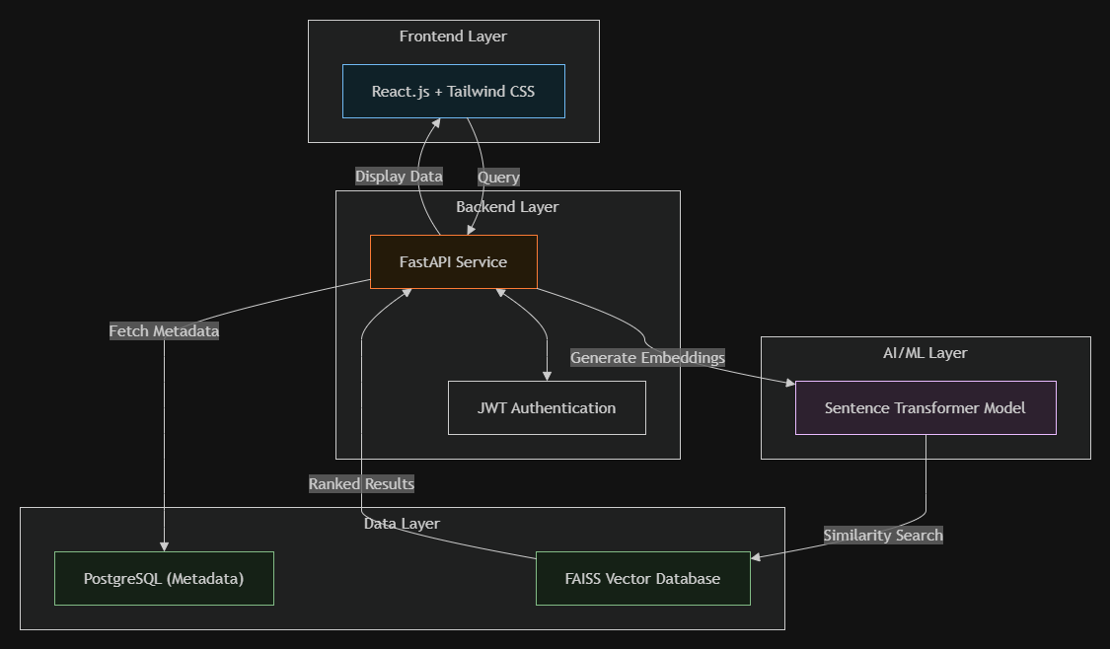
System Architecture

Slide 6
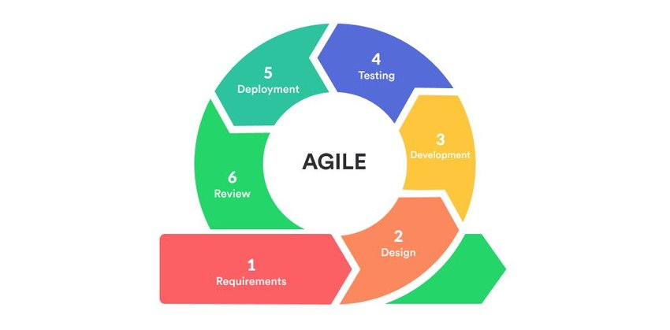
Methodology

Slide 7
Tools and Technology
Frontend
React
Tailwind CSS
Backend
FastAPI
Machine Learning
Python
Pandas
NumPy

Slide 8
Contd..
Scikit-Learn
Sentence Transformer (all-MiniLM-L6-v2)
Similarity Search
FAISS
Database
PostgreSQL
Dataset
arXiv Research Paper Dataset

Slide 9
Team Details
Name | Role
Harshana Basnet | Machine Learning Model Development & Integration
Suraj Kumar Sah | Backend Development & API Implementation
Diwash Karki | Frontend Development & UI/UX Design
Ramabtar Kumar Yadav | Database Management, Testing & Documentation
t.

Slide 10
Expected Outcome
Intelligent research paper recommendation system.
Recommendations based on semantic meaning rather than keywords.
Faster and more accurate literature search.
Improved research paper discovery for students and researchers.
Scalable system capable of handling large research datasets.

Slide 11
Thank You!

